Slide 1

Durham Army cadet force.
Sjt Pinnington.
Chester Le Street Detachment.

Slide 2

Notes:
Official ACF video.

Slide 3
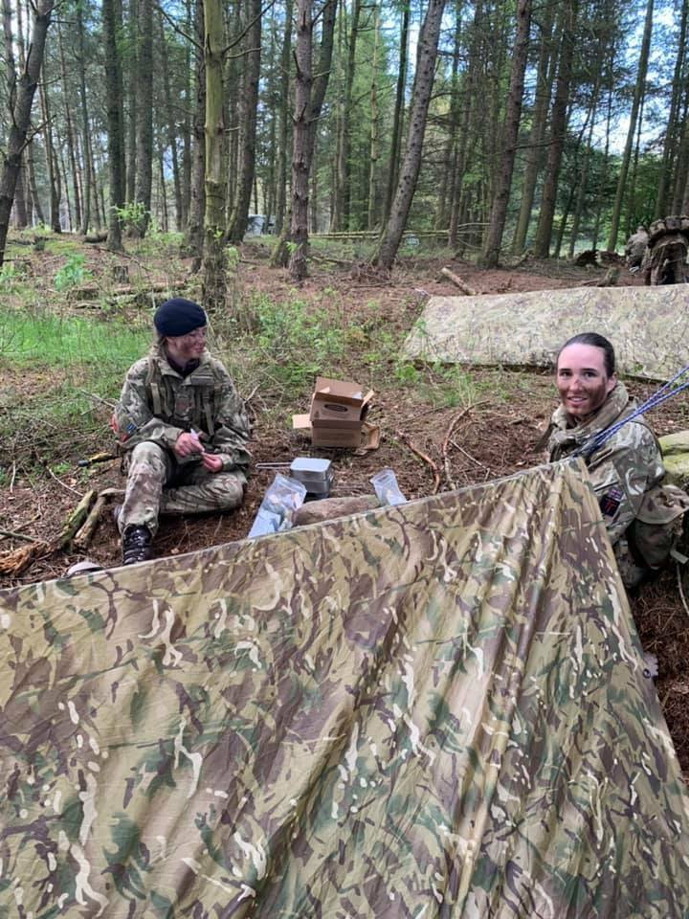
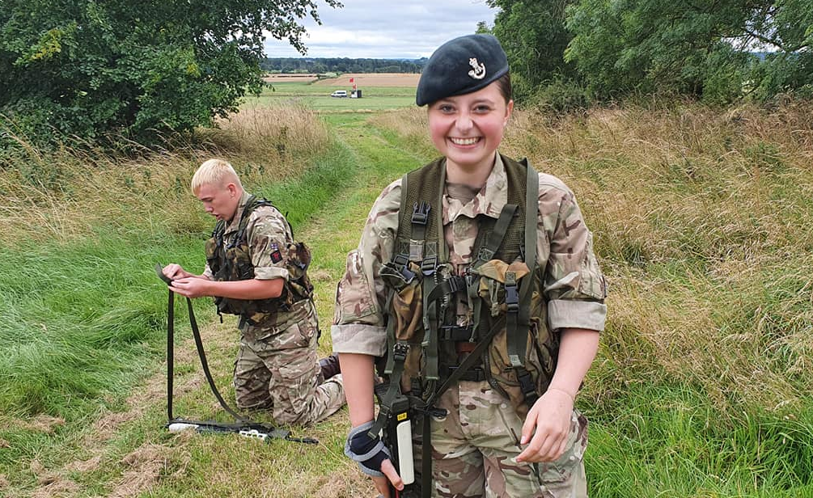
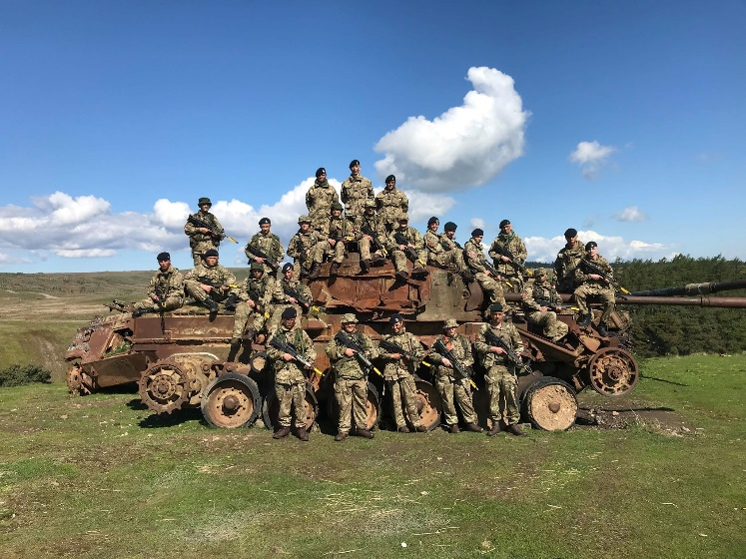
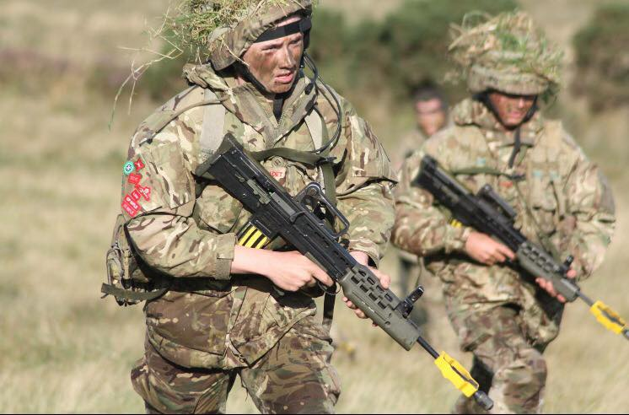
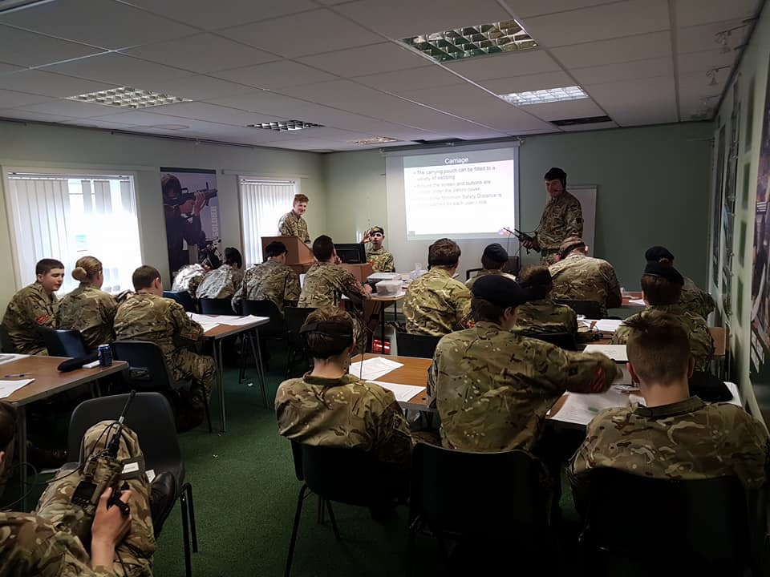
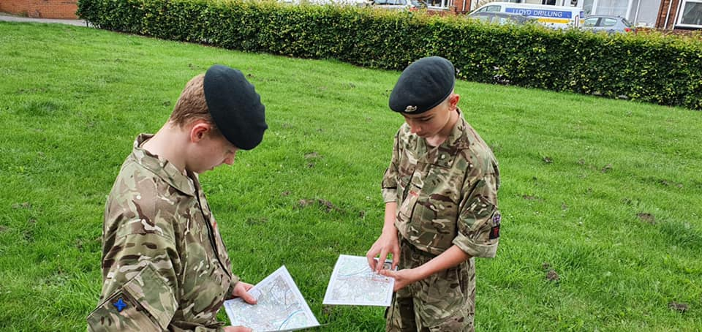
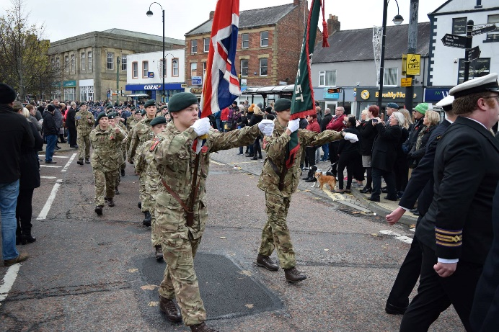
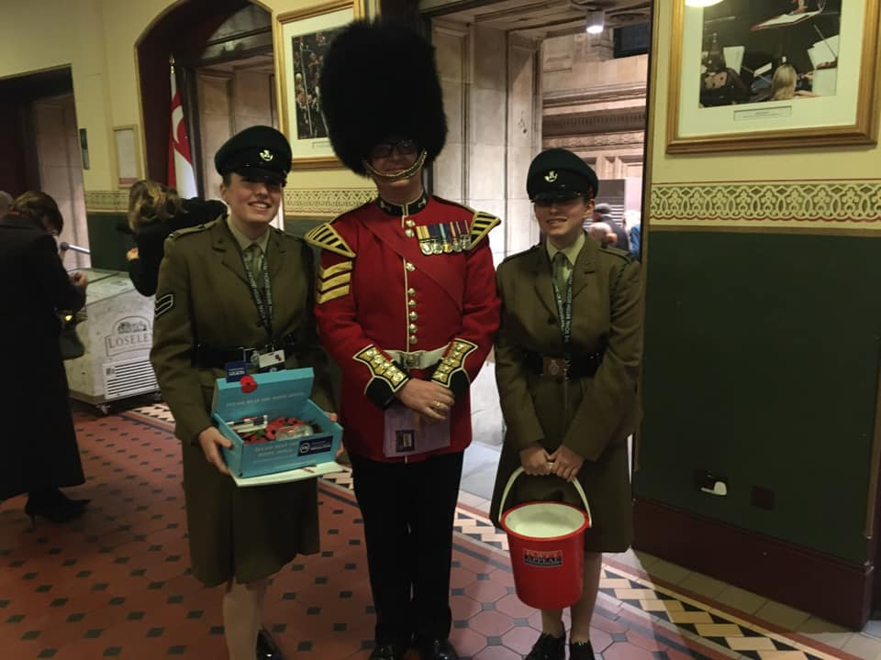
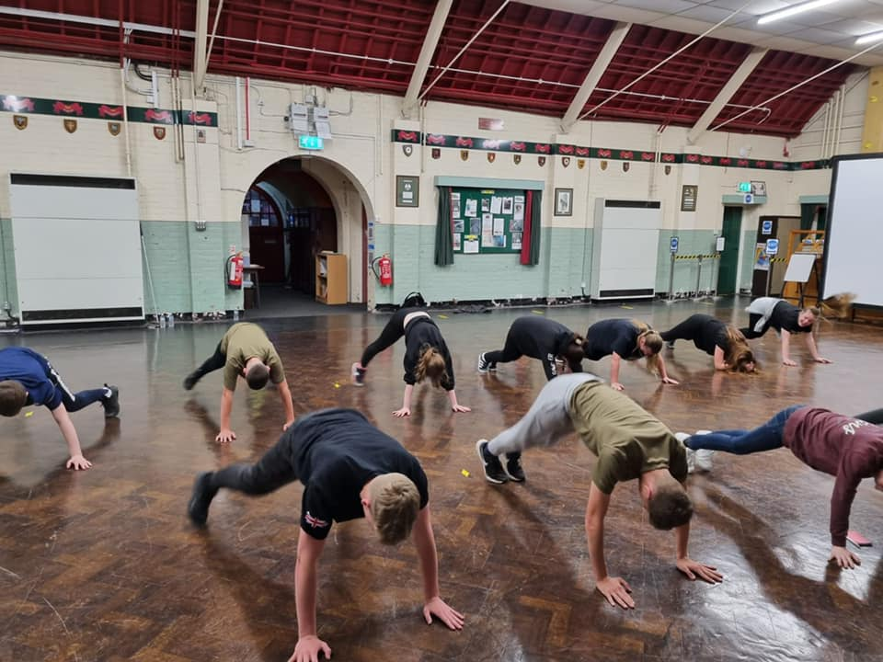
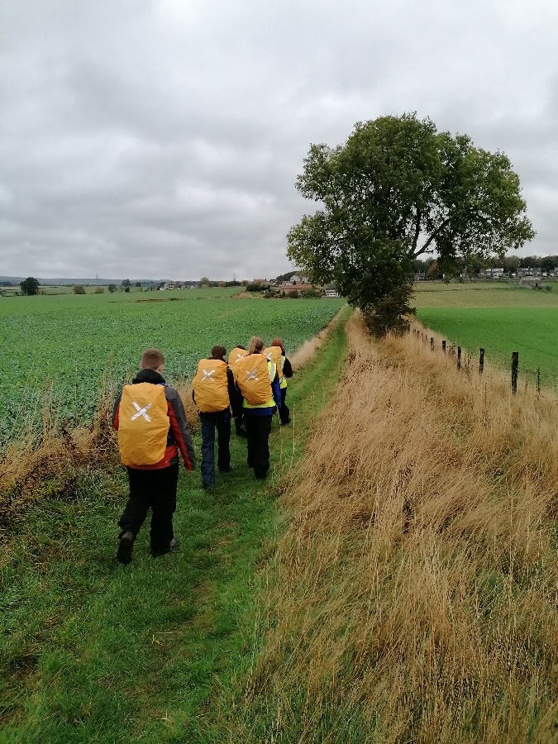
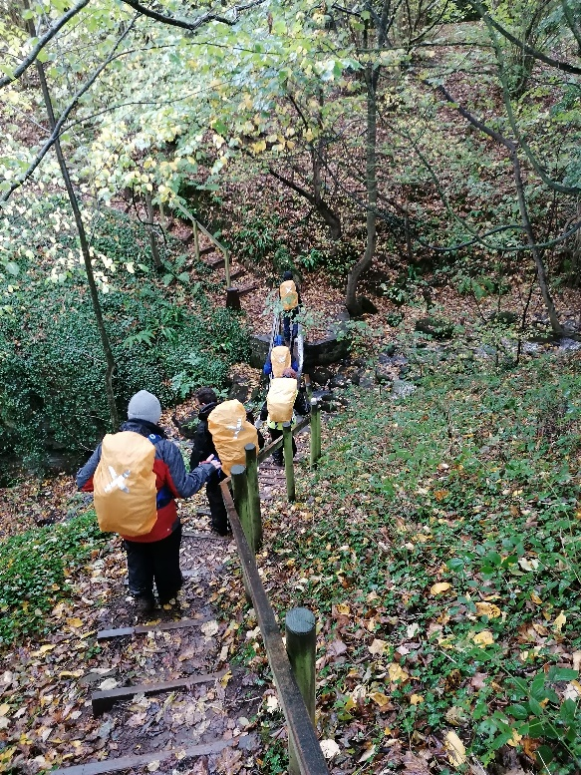
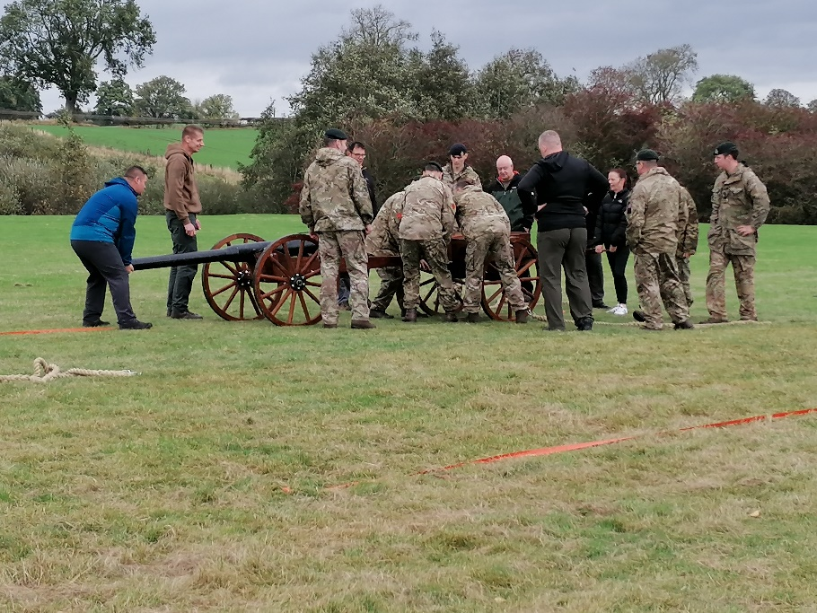

Questions?
Notes:
Discuss ACF activities.
parade nights.
Camps.
APC. Drill and turn out. Shooting (gp rifle, air rifle, 22 target).first aid, Nav, PT, cadet in the community.

Slide 4
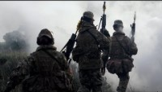
Ex black rat
Notes:
Involvement with others, other cadets, regular and reserve forces.
Show black rat video.

Slide 5



qualifications
    The Duke of Edinburgh’s Award.
    BTEC Level 2 in Public Service.
    Individual Leadership and Management Award Level 2.
Notes:
Other quals.
Reduced costs. DofE normal 140 acf 23.

Slide 6
“how do I join?”
At least 12 years old and in year 8 at school.
Open to everyone of all abilities and backgrounds.
Follow this process to sign up:
  With your parent/guardian, visit www.armycadets.com
  Click “join now”
  Follow the instructions
OR: Visit us at the detachment

Slide 7

Notes:
That was a brief introduction to the ACF.
Any questions ?

