Slide 1
Music

Slide 2
In music we… foster young musicianship for all of our students, through a wealth of engaging and creative music-making opportunities.

Slide 3
Our Curriculum
We have an integrated approach to Performing, Composing and Appraising music.
Performing
As a soloist and in groups
With lots of opportunities for EXTRA performing – lunchtimes/after school
Composing
Creating my own music in many styles, sometimes using ICT resources
Appraising
Finding out about music from a range of genres, styles and traditions
By linking the learning from classroom to practice room to ensemble and beyond, the curriculum provides real, relevant musical experiences for all students.

Slide 4
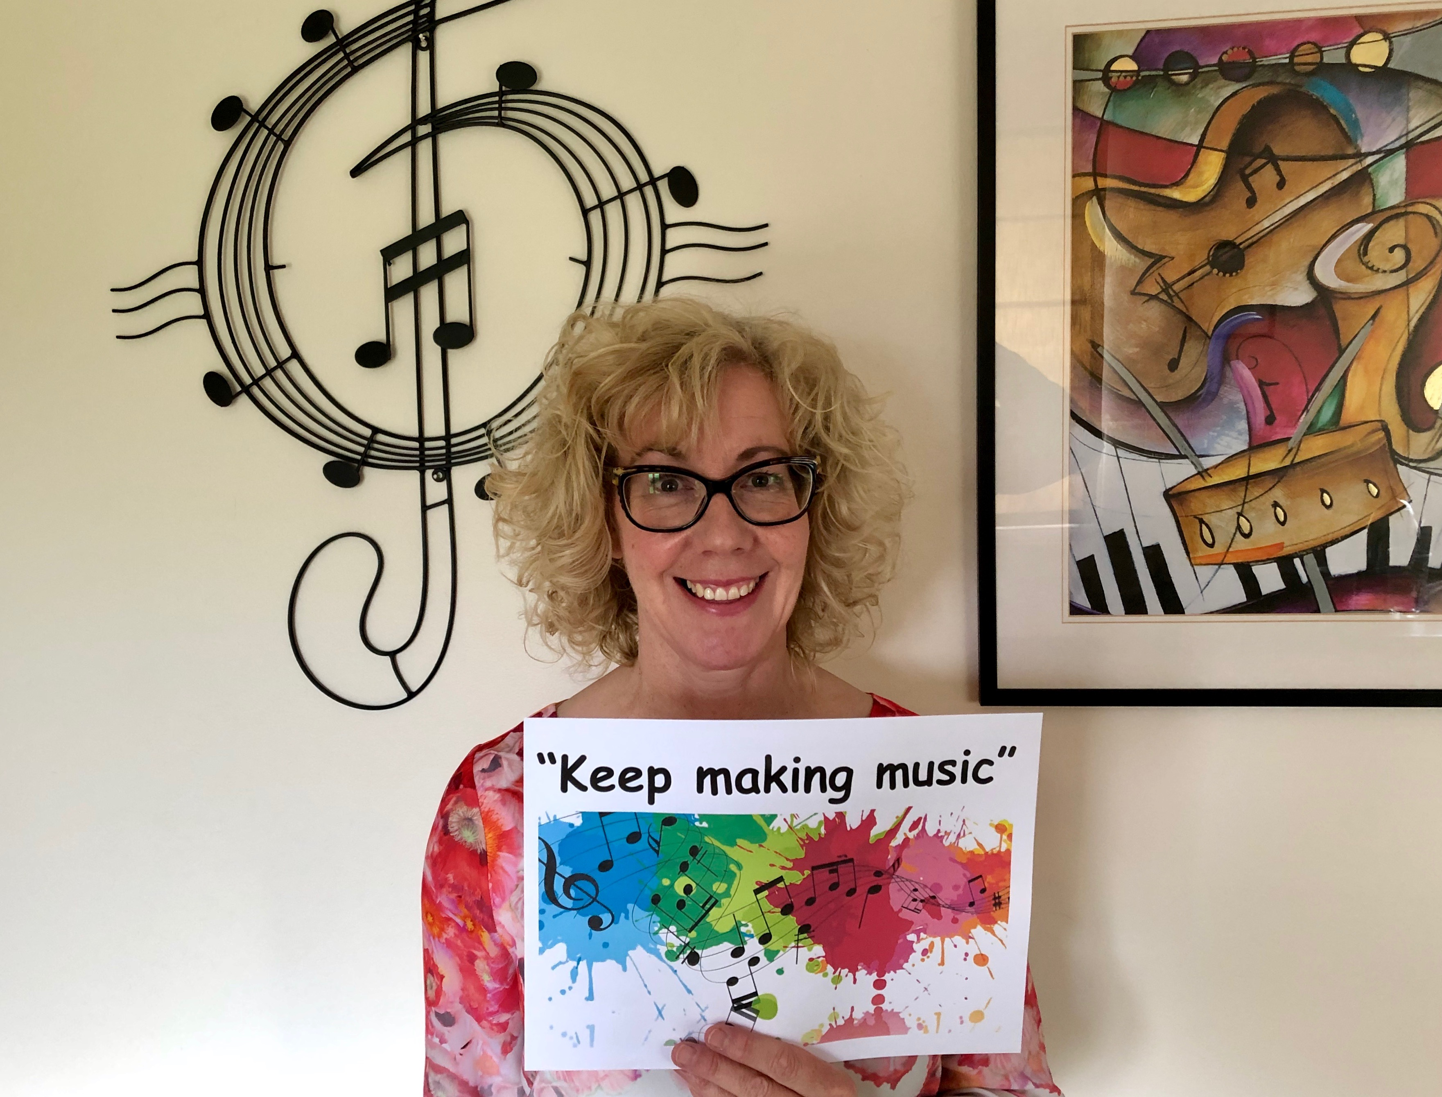
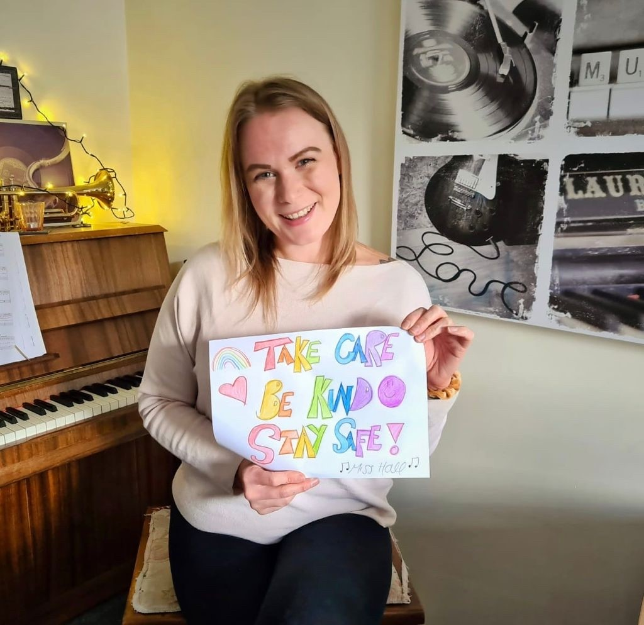
Our Department
Mrs McMullen (Head of Music)
Miss Hall (Head of Year)
We also have 7 visiting teachers from Durham Music Service and Music Works so that you can have lessons on a musical instrument on your own or in a small group.

Slide 5
Music Question…
When we describe the TEMPO of music, do we mean how fast/slow it is or how loud/soft it is?

