Slide 1

Understanding
bullying
www.bullying.co.uk

Slide 2
We Will
Know the definition of Bullying and Online Bullying
Be clear on the types of bullying
Understand signs, symptoms, behaviors and impact of bullying
Consider the choices we have to act and support those involved
Know what to do and who to tell
Share acts of kindness and the feeling of it

Slide 3

The Golden Rules are a set of agreements that guide our behavior towards others.
Notes:
Create a safe and positive environment by agreeing Ground rules.
-Explain we need to create an environment where we feel safe to talk and explore thoughts, feelings and view with out judgement or unkindness.
-Ask each table to discuss what they need to be able to feel safe and positive.
-Have each table in turns to offer an answer- write these up on the white board where they can stay visible
-Agree THESE are now the lesson GOLDEN RULES and challenge these if they are broken during the lesson

Slide 4
Definition of a bullying
“There is no legal definition of bullying. But it is usually defined as repeated behaviour which is intended to hurt someone either emotionally or physically, and is often aimed at certain people because of their race, religion, gender or sexual orientation or any other aspect such as appearance or disability.”
Reference: Bullying UK 2018
Notes:
Part one
Read out the definition so that they have a basic understanding of the definition.

Slide 5

What does bullying feel like?
Family Lives is registered as a company limited by guarantee in England and Wales No. 3817762. Registered charity No.1077722. Copyright © Family Lives 2016
Notes:
Task
Ask all students to stand.
Ask the students whose birthday is between January and July to remain standing and put their hands on their heads.
Ask the students whose birthdays is in either April and May to remain standing and ask them to stand on one leg.
Then ask them how they would feel if they were asked to stand throughout the whole lesson.
Once they describe their feelings (awkward, vulnerable, etc.) you reiterate to them that this is how people feel when they are being bullied even if they don’t show it.

Slide 6



True or false
You can spot a bully from the way they look and act?
Cyberbullying can only affect someone if they are online and have an account too
Bullying is a normal part of childhood and you should just ignore it
Bullying only happens in schools
Reporting a bully will make things worse
It is easy to spot the signs of bullying
It is not bullying if someone deletes the comment or post
TRUE
FALSE
Family Lives is registered as a company limited by guarantee in England and Wales No. 3817762. Registered charity No.1077722. Copyright © Family Lives 2016
Notes:
Read out the questions and have students move to a side of the room/ hold up a true or falls / thumbs up or thumps down (group appropriate)
Fact: There is no such thing as a way a bully looks or acts. There is no specific dress code or behaviour code. Online bullying…
Fact: This is not true, we often hear of pages and fake accounts being created without person’s permission or knowledge. This sort of cyberbullying is on the increase and just as serious as any other form of bullying.
Fact: Bullying is not "normal" or acceptable in any form and ignoring might not always make it stop. If you can, please confide in someone you trust such as a parent or teacher to help you get it stopped. Bullying can knock your self-esteem and confidence.
Fact: This is not the case at all, bullying can happen to anyone at any place. It may be out of school, at university or even college. It can happen when you are out with mates or on the way to or from school.
Fact: You may worry that reporting a bully might make the bullying escalate or they feel they are not believed. It is important to confide in someone you trust so that you can have some help in getting the necessary support to get this stopped.
Fact: It is not always easy to spot the signs of bullying as it is not always physical and obvious. Emotional, verbal and online bullying can often leave scars that people don’t see.
Fact: Regardless of hitting delete, once something is posted online is gets its own unique URL which means that it can stay on cyberspace even if you hit delete.

Slide 7

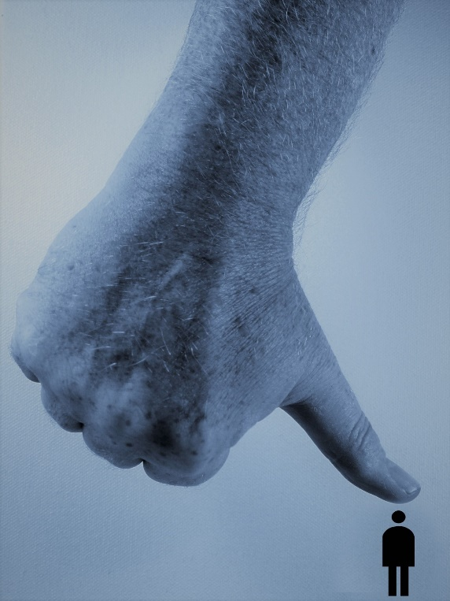
The different types of bullying
(Repeated & Intended to hurt)
Physical (when smeone pushes you, hits you or harms you in any way physically)
Name calling (using insults and offensive nicknames)
Social (leaving out, fake rumours, damaging a person’s reputation, excluding others, online and offline)
Cyberbullying (being bullied online, via social networks, apps, messenger and phones)
Sexual (unwanted sexual advances, pressurised to do sexual things, sexting, sexuality, spreading sexual rumours)
Notes:
Explain the different forms of bullying:
Physical: When someone pushes you, hits you or harms you in any way physically
Name Calling: Also known as verbal bullying, using insults and offensive nicknames
Social bullying: Also known as Relational bullying or emotional bullying, this can include leaving out, fake rumours, damaging a person’s reputation, excluding others, online and offline, turning friends against a person, etc.
Cyberbullying: Being bullied online, via social networks, apps, messenger and phones, trolling, etc.
Sexualised bullying: Unwanted sexual advances, pressurised to do sexual things, sexting, sexuality, spreading sexual rumours

Slide 8






The scars bullying can leave - task
Family Lives is registered as a company limited by guarantee in England and Wales No. 3817762. Registered charity No.1077722. Copyright © Family Lives 2016
Notes:
-Give the students or each table 2 pieces of paper and ask them to put one on the table and screw up the other one as tightly as they can (passing between each one on the table to screw up if working as a table).
-Once they have done this, ask them to unravel the screwed up piece of paper and try to straighten it out the best they can.
-Then ask the students to hold up the two pieces of paper and compare the differences.
-Ask them to tell you what the differences are.
-Then you can reiterate to them that no matter how much you try to straighten things out, the scars of bullying remain.

Slide 9
What are the main effects of bullying - task
Type of bullying | Why does it happen? | How does it make a person feel? | How can this affect their life?
Example: Calling someone “gay” | To intimidate someone | Anxious and depressed | Not go to school
Family Lives is registered as a company limited by guarantee in England and Wales No. 3817762. Registered charity No.1077722. Copyright © Family Lives 2016
Notes:
-Read students the comments below
-Students discuss and complete the table under the headings.
-Pull responses together for a group list.
-Share / compare – summarised examples ON NEXT 2 SLIDE
‘’Someone who is being bullied in this way may feel lots of different emotions. Often a young person might act like they are ok on the outside but inside they may be feeling very low. They might not want to show how they are really feeling in case others think they are making a big deal out of nothing, or cannot take a joke and perhaps they are even worried it might get worse.
They may also start to believe the verbal bullying and this will knock self-esteem.
To understand how a person feels on the inside, it is important to try and see how they might be feeling if they are being called these names day in and day out.’’
Encourage them to give specific examples in the types of bullying column. Allow them to do this for 10 mins and then present it to the class.

Slide 10
Bullying can
make you feel:
Depression
Anxiety
Isolation
Withdrawn
Suicidal
Humiliated
Low
Upset
Angry
Frustrated
Blame themselves
Hate themselves
The impact of bullying:
Self-harm and depression
Suicidal thoughts/attempts of suicide
Withdraw socially and isolation
Avoid going online/social media
Feel anxious about going to school or work
Feel angry and aggressive
May feel a need to bully others
Develop an eating disorder
Turn to drinking or taking drugs
No self-esteem, self-worth or confidence
Notes:
-Share / compare examples

Slide 11

What about how bullying affects other areas of life?
Family life
School/college work
Relationships
Friendships
Socially online and off
Emotional well-being
Future relationships
Mental health
Future plans in life
Children who are bullied can still experience negative effects on their physical and mental health more than 40 years later, say researchers from King's College London. Those bullied frequently as children were at an increased risk of depression and anxiety, and more likely to report a lower quality of life at 50.
Notes:
-Share with the students:
‘’Bullying can and does affect people’s feelings and other areas of their lives. If you see someone being bullied then you may think they are just taking it well or not bothered, but inside how a person feels may not show on the outside. If it becomes regular, they may change their behaviour as a result of the bullying. It can also affect other areas of their life, including friendships, school work and family life. There has been cases where young people and their family have moved and made a new life elsewhere because of bullying.’’

Slide 12
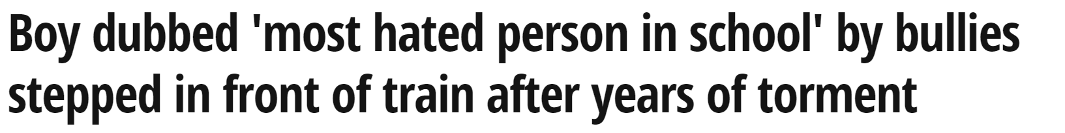
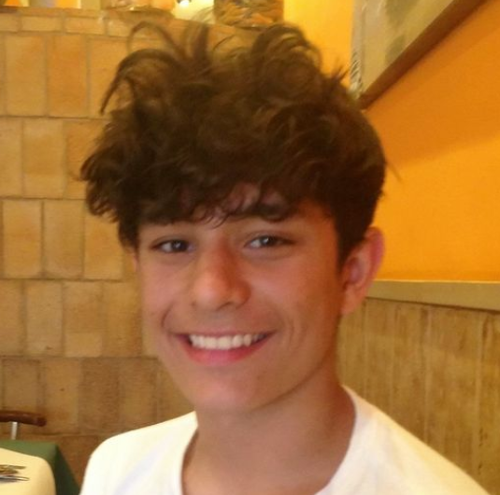
Felix Alexander's years of abuse began in 2009 following a playground argument about violent video game. The 18-rated game had just been released but Felix, then aged ten, was branded a "p****" by classmates at school after he admitted his parents had banned him from playing it. He was 10 years old.
His confidence and self-esteem had been eroded over a long period of time by the bullying behaviour he experienced in secondary education. It began with unkindness and social isolation and over the years, with the advent of social media, it became cruel and overwhelming. People who had never even met Felix were abusing him. He was however so badly damaged by the abuse, isolation and unkindness he had experienced, that he was unable to see just how many people truly cared for him.
He had been targeted for many, many years. It started with social isolation when he was around ten. He didn't get invited to parties and wasn't included in weekend activities. Then the online abuse started when he was 14. He was once known as "the most hated" pupil at his school and, despite switching schools , the bullying continued until he could no longer cope. One morning, Felix told his parents he was getting the bus to school but instead went to the railway tracks. He was killed instantly when he was struck by a train near his home.
Reference: Mirror newspaper
Notes:
!!! Consider your group and emotional maturity – are they ready to hear if the possible extreme of bullying?
-Pre-warn of sad, sensitive information
-Read out the case study, sourced via the Mirror Newspaper. This will help young people to understand how far bullying can go and how it can make a person feel.

Slide 13

Our national bullying survey reveals
81% of young people experience name calling and 50% were bullied because of appearance
73% said workplace bullying was verbal including threats and 60% said they experienced social bullying at work.
40% young people have had suicidal thoughts 67% felt depressed as a result of being bullied, 39% have self-harmed.
68% said that bullying has had a huge impact on their self esteem and 70% felt it has left them angry/aggressive.
90% said that bullying happened at school and 68% were bullied online.
Notes:
-Highlight 2019 statistics:
These statistics are from our National Bullying Survey, which ran for 2 years.
Explain that we can work together on the next activity to make explore how the choices we make can result in us being a support or a bystander.

Slide 14
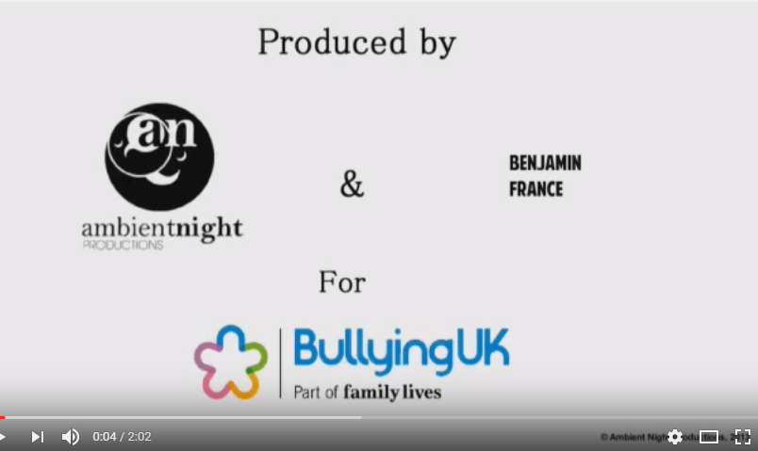
Interactive bullying video
Youtube video
https://www.youtube.com/watch?v=eyn022bDplw&feature=youtu.be
Discussion pack: https://app.pelorous.com/media_manager/public/209/Images/BullyingCompetition/Interactive%20film%20downloadable%20pack.pdf
Family Lives is registered as a company limited by guarantee in England and Wales No. 3817762. Registered charity No.1077722. Copyright © Family Lives 2016
Notes:
This interactive anti-bullying video
It was created entirely by young volunteers.
As a class watch and vote on the choices as they appear- this can be played several times to see what the alternative choices could result in.
Throughout this video you will be asked to make a decision from the point of view of the bully, the victim or the friends. These choices will alter the story as you go.
* Below the video be sure to click ‘SHOW MORE’ for the option to click to adjust the story.
Teachers can Print (one drive) the discussion pack with questions to ask students

Slide 15

How to get the bullying
to stop
Tell a parent or a family member
Report the bullying to a teacher or a trusted adult like a coach
Be assertive with the bully and say their name calling is boring but not aggressively
Ignore it and walk away with no reaction then report it
Keep a diary
Family Lives is registered as a company limited by guarantee in England and Wales No. 3817762. Registered charity No.1077722. Copyright © Family Lives 2016
Notes:
Report the bullying to a teacher or someone at school you feel safe with. They may be able to take action and get the bullying to stop. If you are worried that it might make it worse, perhaps you can ask the teacher to just keep an eye on it as they then might see it themselves and take action.
Tell a parent or a family member. This can give you lots of strength and a parent or family member can help you to get the bullying to stop. They can also give you lots of emotional support. It is important to try and tell someone in your family what is going on so you are not bottling things up. Talking about what you are going through can give you courage to get it stopped.
Be assertive with the bully and say their name calling is boring but not aggressively. However, it is important to ensure that this course of action doesn’t cause them to become aggressive or make the bullying worse. You may think a quiet chat with them when they are on their own might work, but if you do so, please take a friend with you for support.
Ignore it and walk away with no reaction. Quite often the bully stops when they are no longer receiving attention or a reaction from the bullying. It is always difficult to try and ignore it especially when it is so upsetting or if it is constant but if they don’t get a reaction, it can stop.
Keep a diary – it is very important to keep a diary of times and dates of all incidents no matter what it is from name calling, physical, anything that is relevant.
It is really important to try and keep your cool in these situations even though the name calling bullying might be making you feel very angry. It is natural to feel this way but if you get aggressive and things turn nastier or physical then someone could get seriously injured or into trouble with the police. This is why it is important to get some help to get the bullying to stop.

Slide 16

Why might someone bully others?
Notes:
Empathy is a difficult skill, however its important to have student discuss why a bully may do so, in order to reflect on the fact that often the bully is very unhappy and need support themselves.
Have students explore possible reasons, that could write this on the board/ on post its so that the teacher can share the honesty in a confidential structure.

Slide 17


Notes:
Double click on the screen and the YouTube video will play, this is the link for the video https://www.youtube.com/watch?v=wrTJIp14O-w – this is about bullying and the bully!

Slide 18


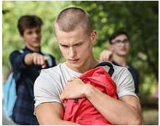
Select bullying type
Map out scenes
Include Intro/ setting
Select Characters
Plot story
Include Successful outcome
Notes:
(PRINT) Anti- bullying comic strip resource
Student create their own comic strip.
Some students might be confident enough to have their story shared with an other peer? Post its to add peer review of each others:
Differentiate Eg- WWW and EBIs / How could peer change the ending of the strip for the better / identify the type of bulling, signs, symptoms in the strip.
- If a student is happy to have theirs projected on a visualiser this could be used as a whole group Q+A summary task.

Slide 19

Online bullying and harassment
Cyberbullying is any form of bullying which takes place online. This can be done over smartphones, tablets, online gaming, chat forums, social and other media. Online harassment is the act of sending offensive, rude,
and insulting messages and being abusive.
Notes:
Part 2
-Read out the green statement above so students understand the definition.

Slide 20








Notes:
-Ask each one to show hands for what social media/gaming sites are presented – this could be a table/ who group Quiz
- Write up which social media/gaming sites students use that are additional.
Snapchat
X-Box
YouTube
Playstation
Facebook
Twitter
Instagram
Whatsapp

Slide 21

https://www.youtube.com/watch?time_continue=4&v=oAmVkVEmOP4&feature=emb_title
Notes:
https://www.youtube.com/watch?time_continue=4&v=oAmVkVEmOP4&feature=emb_title
Point out that we all have a choice and responsibility's- positive change starts with everyone of us
Play the video - teenagers views.
*This task can be an extension task towards the end of the session where students/groups/ class create their own sound over or video and sound over.

Slide 22

Online rules - don’ts
- Only use your own profile and password
-
-
-
-
-
-
- Screenshot offensive messages for record
-
-
-
-
-
-
Notes:
Have pairs or small groups of students discuss and list rules they know when being online and communicating online
Have pairs or small groups of students discuss and list online bullying advice for others.
Have printed or share the information below to scaffold responses as appropriate:
Screenshot - If you receive offensive or harassing messages make sure you screenshot them or save them so you have a record of what was said as if the police do get involved, they will need this.
Make privacy settings strong - change password regularly, review privacy settings regularly as this helps minimise bullying messages.
Sign out sites on public computers or if you are using a friend's device.
Don’t get into an argument or post offensive material
Don't get into arguments online, this is called flaming and it can get nasty. If you break the rules of whichever site you're on then the content is likely to be removed and you might have your membership terminated. You're not allowed to upload anything which is offensive or racist and which promotes physical harm so don't make threats to anyone. Neither are you allowed to harass people or to encourage other people to harass them. You're not supposed to ask for personal information from anyone under 18 either so if you are under 18 and anyone asks you, for instance, where you go to school, make sure you report them.
Spreading rumours
Don’t spread rumours or make up false things about a friend you have fallen out with. You are not allowed to upload anything which is threatening, abusive or which is defamatory. It's defamatory if you say untrue things about someone which give them a bad reputation they don't deserve. It can also be harassment which is a criminal offence in the UK.
Consent and fake profiles
You're not supposed to upload a picture or video of anyone without their permission either. So never set up a social networking website account in the names of other people or upload false information about them.

Slide 23
Online bullying advice
Screenshot any offensive or harassing messages
Check your privacy settings and don't accept followers you don't know.
Check your location settings and turn them off.
If you are being bullied online, stop communication with the other person and screenshot it.
Block the other person.
Report the bullying or harassment to the provider.
Confide in someone you can trust so they can help you to get the bullying to stop.
Notes:
Students have been tasked to create a one paged poster/ screen page/ warning screen/ online membership agreement contract for one of the social media/ gaming sights they use.
The presentation must include some of the previous task information and be colourful, engaging, factual and remind users of the importance of being kind and responsible online.

Slide 24

https://www.youtube.com/watch?v=RGcLa-vyxVQ
https://www.stopspeaksupport.com/
Notes:
https://www.internetmatters.org/issues/cyberbullying/stop-speak-support/ (option of parent link to advice also)
Play one of the two options of videos (group appropriate) with some advice from teenagers as how to deal with online bullying.
This leads in to the next task but * can be used to inspire an extension/ embedding task eg- create own poem/slogan/video/play

Slide 25
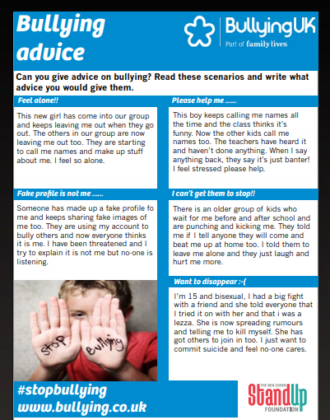
Notes:
-Students complete a response as an agony aunt/uncle for each problem
*Copies of the resource are available in the one drive folder (PRINT) Bullying advice tablet resource
*Scaffold resource available (PRINT) Building self resilience resource as appropriate.

Slide 26

Notes:
-Double click on the screen and the YouTube video will play, this is the link for the video https://www.youtube.com/watch?time_continue=1&v=X4PmHy6bViw

Slide 27

https://www.youtube.com/watch?v=Rj4Yu9Utdw0
Notes:
https://www.youtube.com/watch?v=Rj4Yu9Utdw0 – Play song/ video during activity.
(Print) off choose kindness resource and cut out/ have students cut out positive words
Ask the students to take one or two each and pass them onto their fellow classmates.
Ask each student to make up one or two of their own positive words or affirmations on the blank cards.
Ensure that everyone receives one of these words. *including the teacher in the task can support / preempting this happening.
Use the experience as a point of classroom discussion, finding out how they felt, what it would mean for someone who is being bullied to feel other’s kindness, etc. The words can also be displayed in the classroom as a reminder of choosing kindness.

Slide 28

Connect with us
Helpline: 0808 800 2222
www.bullying.co.uk
bullyinguk@familylives.org.uk
@BullyingUK
Family Lives is registered as a company limited by guarantee in England and Wales No. 3817762. Registered charity No.1077722. Copyright © Family Lives 2016
Notes:
-Signpost a support option
-Have students record this in their tutor time reflection page in their planners

Slide 29
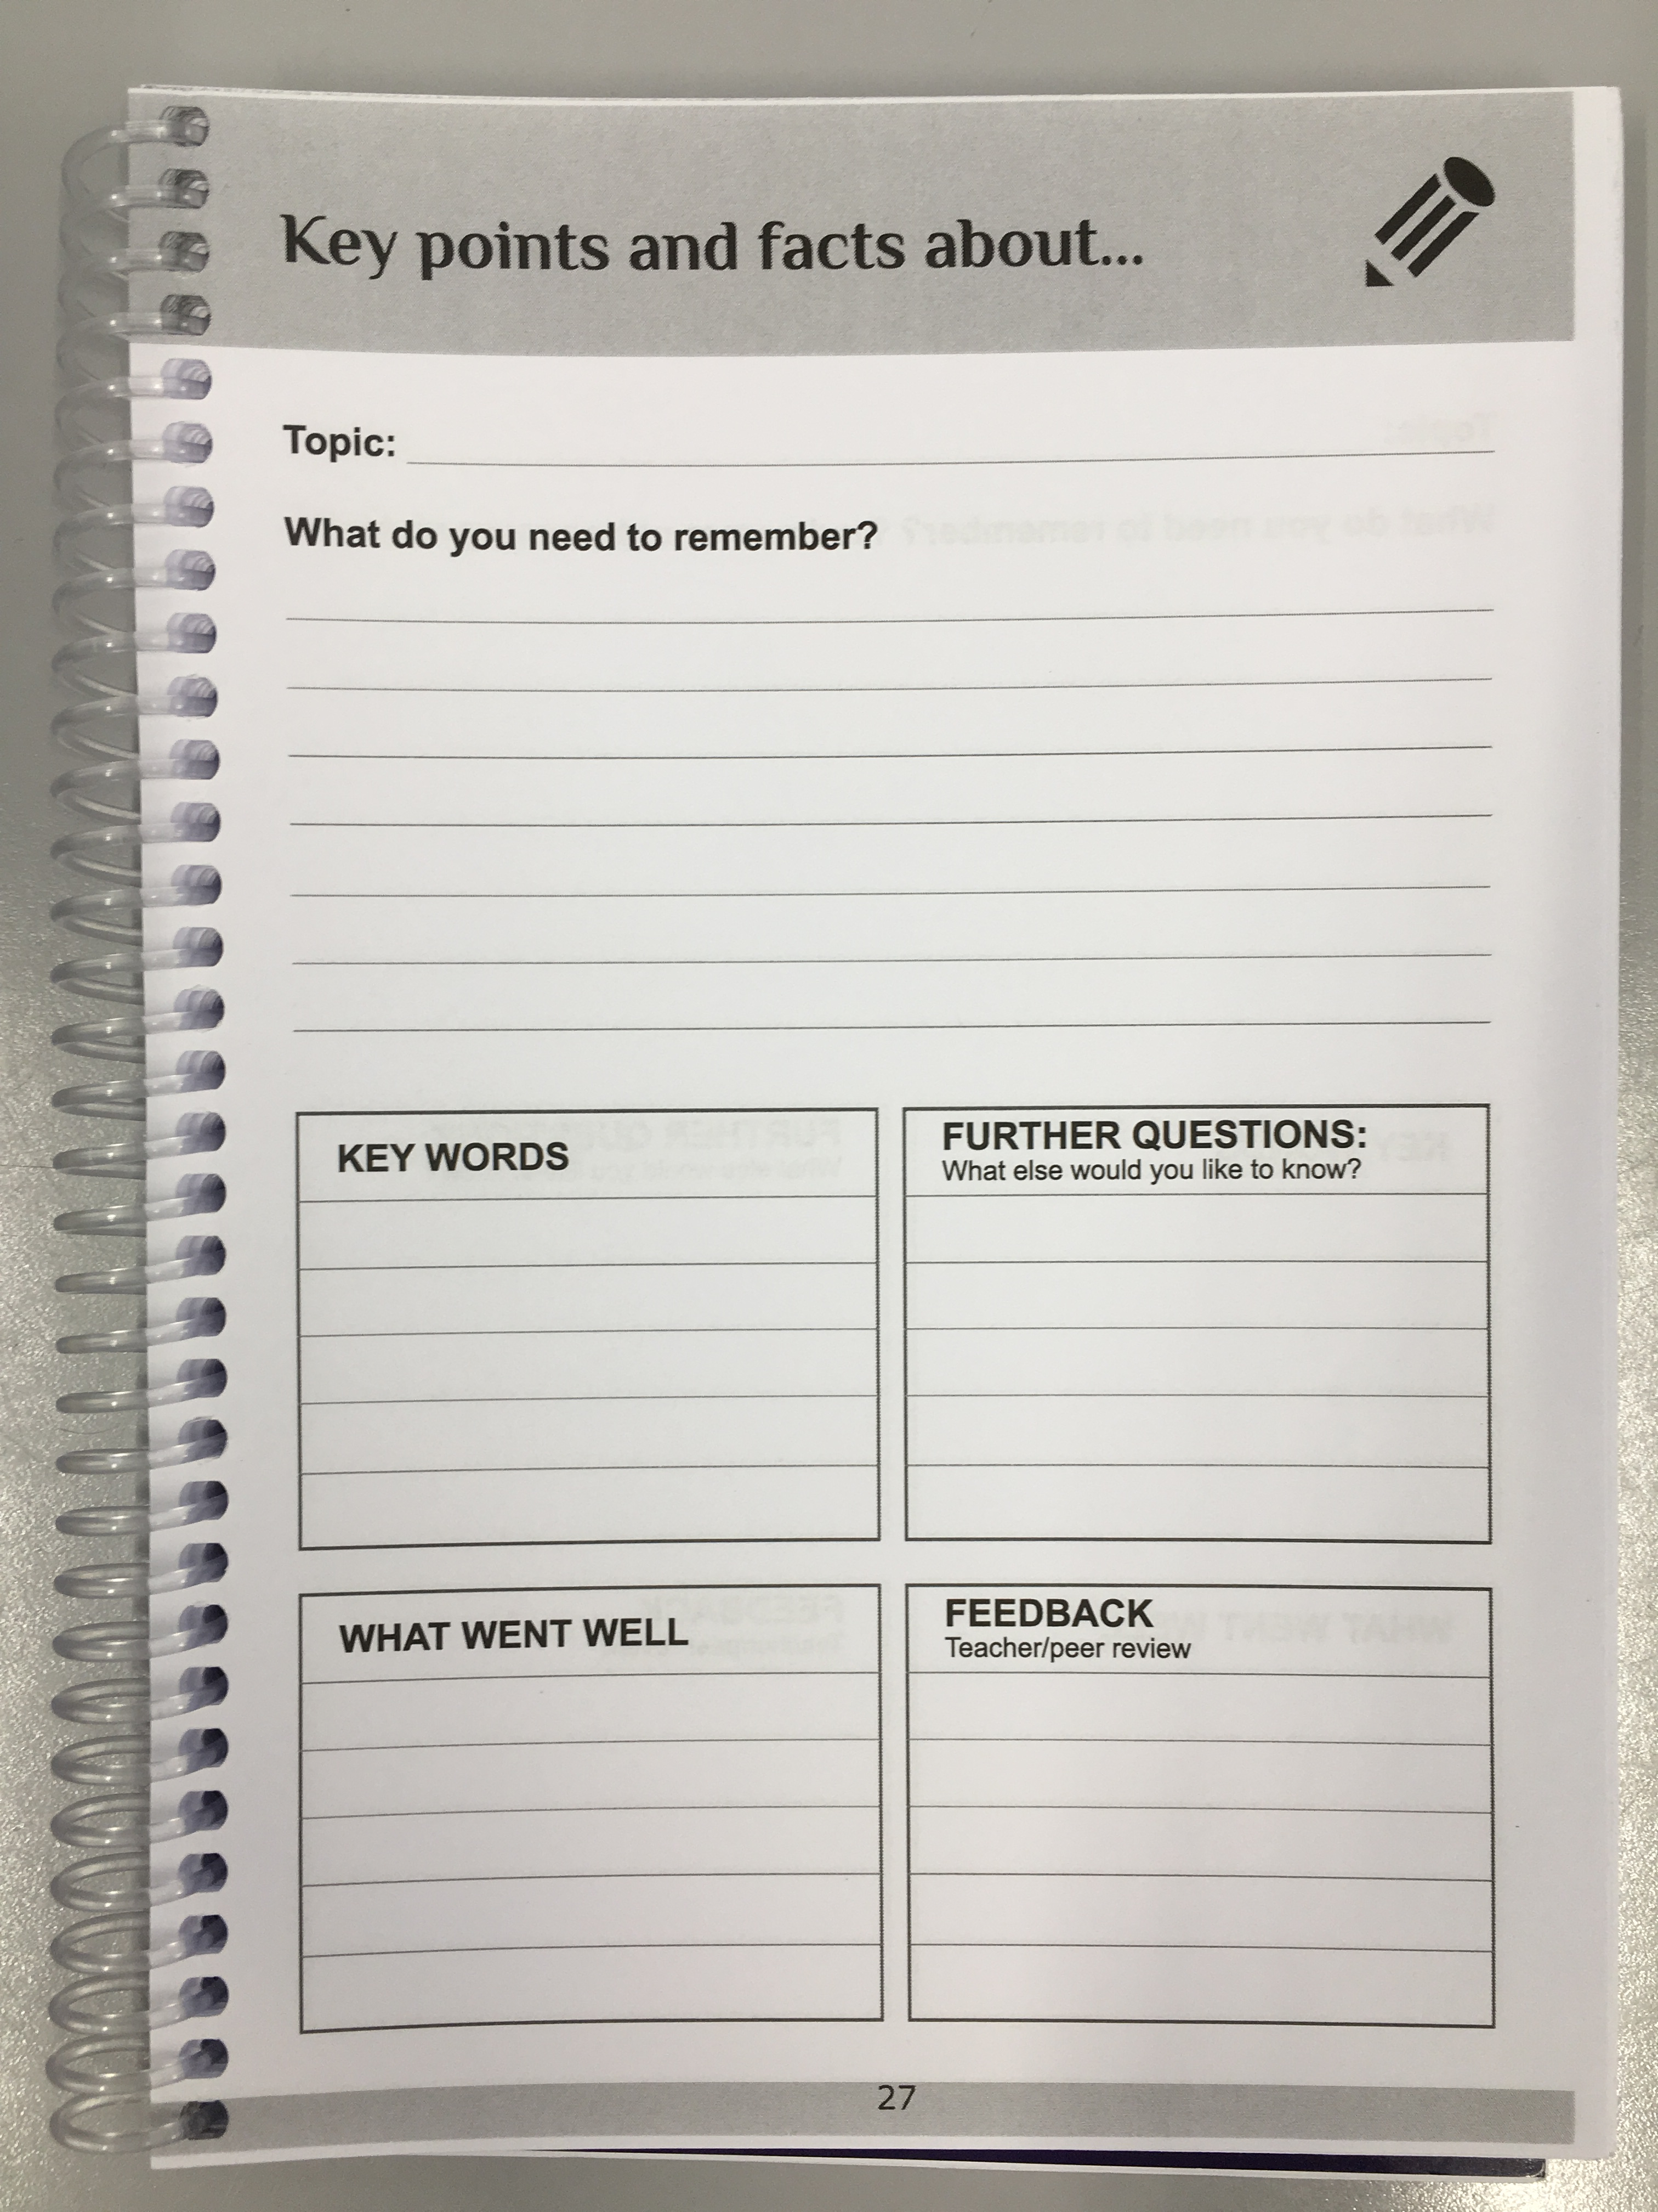
Reflection
What are facts you have taken from the lesson?
What are your options to stop bullying?
Notes:
-Students are to reflect on their lesson using the appropriate pages in their planners
-What are students positive options to stop bullying? What are the key facts they have learnt from the sessions?
! Emphasise/ signpost the helpful website related to the topic (previous slide).
* HOY will review a sample of these for QA of planner use over the year
*DSLs will review a sample of these to gather students voice for Session EBIs and next steps

