Slide 1
Hermitage Academy Welcome to the Physical Education Department

Slide 2
Meet the PE team
Please spend some time to visit our excellent facilities, meet our amazing staff and please ask us anything were here happy to help

Slide 3
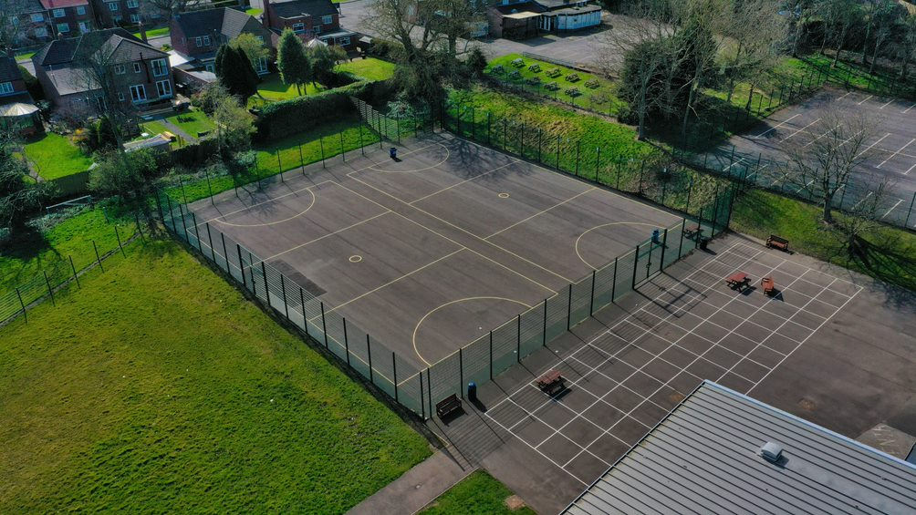
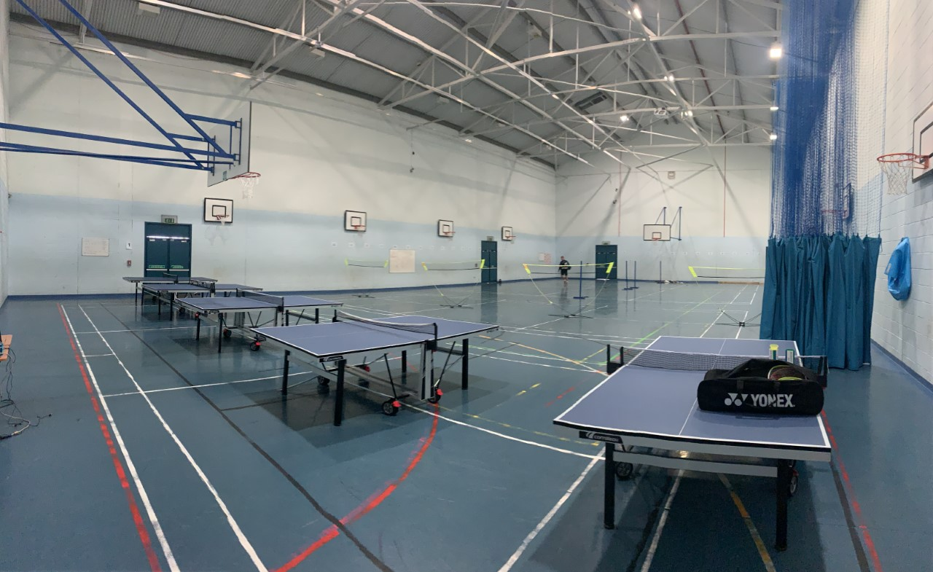
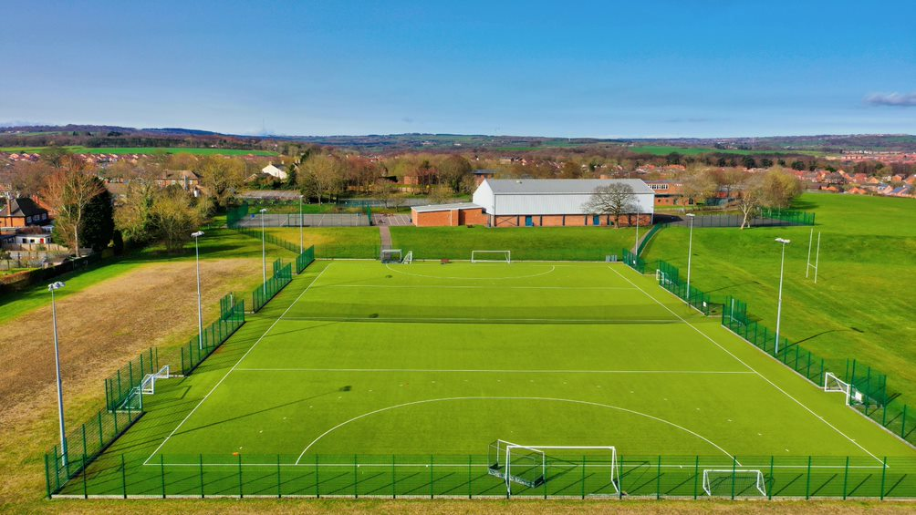
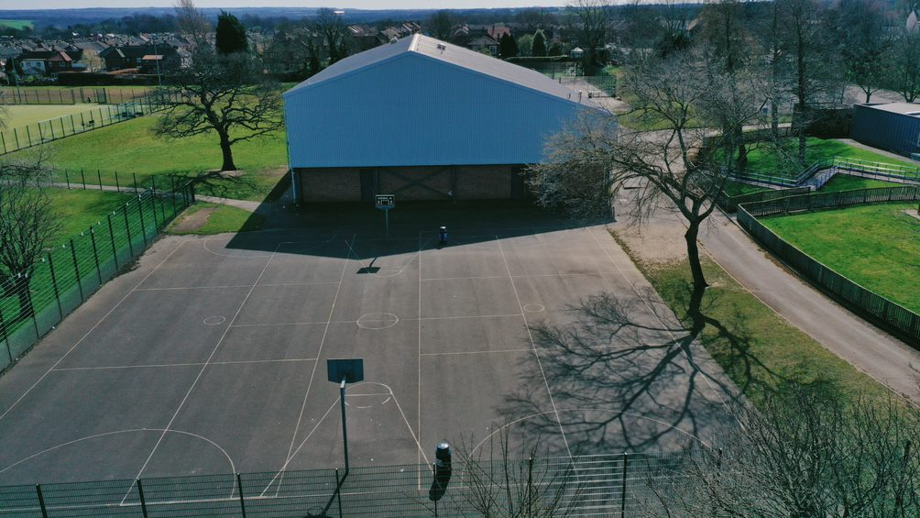
Hermitage Academy Facilities

Slide 4
Astroturf, Rugby and 5 Football Pitches

Slide 5
Full size Astroturf Hockey Pitch

Slide 6
Multi-Purpose Sports hall

Slide 7
Netball Courts & Training Grids

Slide 8
Dedicated PE Classroom and Computer Suite

Slide 9
Uniform
Please check out our brand new PE kit
Sector polo - only available from Emblematic.
Sector panel shorts and/or skort and/or cuffed tracksuit pants and/or leggings - only available from Emblematic.
Knee high navy sports socks - available from Emblematic or any supplier
Other optional items are available - see uniform visuals below.
Trainers must be worn in PE lessons. Plimsolls, Converse, or canvas type shoes are not suitable. Students are advised to wear football boots for football and rugby. Optional items are available and can be viewed on the website.

Slide 10
Extra-Curricular Clubs
Every half-term we offer a new range and variety of Morning, Lunch and Afterschool sports and activities.
We try to follow our seasonal sports and have regular Boys and Girls Football fixtures, a full Netball season and Summer Sports and Activities in Athletics and Cricket seasons too.

Slide 11
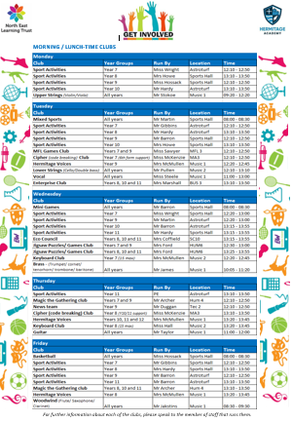
Morning & Lunch-Time
Clubs and Activities
We now have morning and afterschool clubs available to everyone in all years, before school and year groups have access to the sports hall and Astro turf on pre-determined days.

Slide 12
New Afterschool Timetable
We now have for each half term a full curriculum of after school extra curricular activities these can be found on the school website and they alternate around the seasons.
Here is our Autumn Half Term 1 offer.

Slide 13
Year 7 Curriculum

Slide 14
Year 8 Curriculum

Slide 15
Year 9 Curriculum

Slide 16
Academic Qualifications
At KS4 we offer students the option of two different academic qualifications for PE GCSE PE (AQA) and BTEC Tech Award (Pearson) in addition to core PE Lessons
At KS5 we also offer a choice for students to further study sport in Sixth form with A-Level Sport (OCR) and BTEC Extended Diploma (Pearson) Level 3

Slide 17
Hermitage IOS Course Institute of Sport
At Hermitage we have a unique offers as well as A-Level and BTEC Sport in sixth form…
Hermitage IOS – Institute of Sport – we have a selected number of students who are either elite performers, coaches, officials who we as a school support with our partners at Durham University and you receive free kit, clothing, goody bags etc.

